Slide 1

The Battle of Neighborhoods
--Kethidi Anjali Reddy

Slide 2
Introduction/Problem
-Universities such as The New York University and Columbia University in New York city are dream unis to land in for Indian students for their higher studies .
-This project is aimed for students from Indian Background who prefer to have Indian Cuisine over others.

Slide 3
Introduction/Problem
Problem: List out the places in New York city where Indian Restaurants can be found and also find out which place would be preferred to stay if a person prefers Indian Cuisine ?

Slide 4
Data
1.(“http://cocl.us/new_york_dataset”)New York City data that contains list Boroughs, Neighbourhoods along with their latitude and longitude.
2.Foursquare API-To obtain the venues and data about restaurants.
3.(“https://data.cityofnewyork.us/City-Government/Borough-Boundaries/tqmj-j8zm”)Used to Visualise data on maps

Slide 5
Methodology
1.Obtain New York Data about neighbours and Boroughs along with lats and longs.
2.Get venues of restaurants in these above places
3.Segregate Indian restaurants
4.From Foursquare API find ratings and likes of the indian Restaurants
5. Sort Neighbourhoods and Borough the data keeping Ratings as the constraint and join this dataset to original New York data to get longitude and latitude,then finally locate them on map.

Slide 6
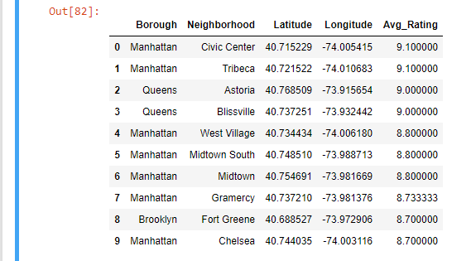
Results

Slide 7
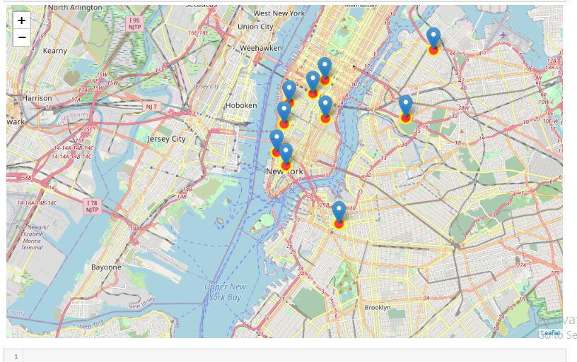
Results

Slide 8
Conclusion
The similar procedure can be used for finding the restaurants of people's choices mainly for students coming from different parts of the world.

